Slide 1
Suicide Trends in Japan
Jump, inertia, age change, and decline
Age 40-50, male, unemployed or economically troubled self-employed
fiancial crisis & credit crunch
Age 20－39, suicide increase
Elders suicide decline
Temporal workers
Lost 2 decades
> Age 60
Basic law (2006)
Suicide prevention fund
Jump Inertia decline
Age change
All
In April 2016, the Basic Law was revised, making prefecture- and municipality-level suicide presentation policies mandatory
Unemployment rate （right）

Slide 2
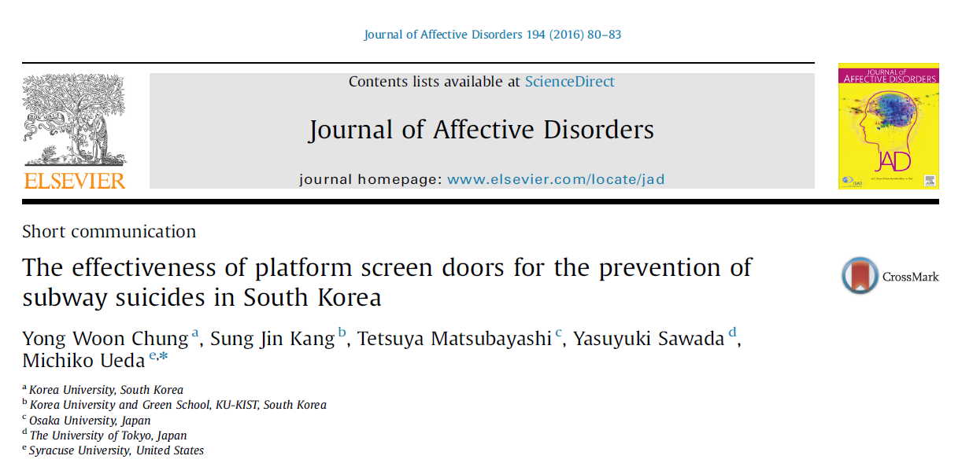
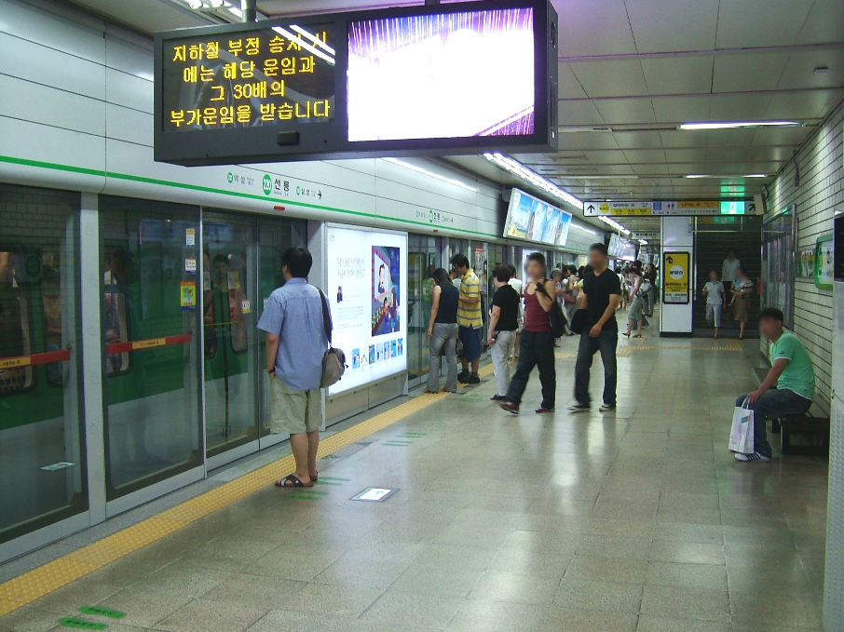
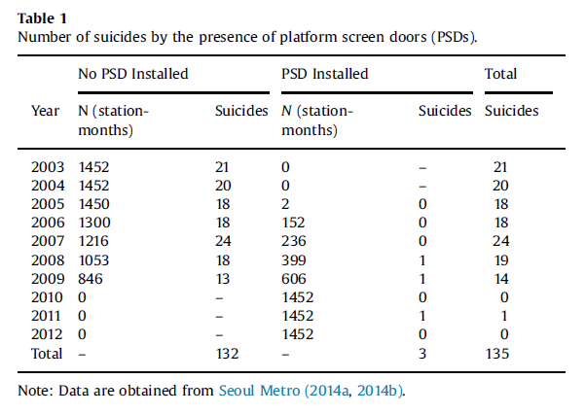
Suicide prevention policies
2003-2012 data from
Seoul metro, Korea
Screen doors
89% decline in suicides

Slide 3
Clinically significant depressive symptoms in China, Korea, and Japan by Age & Sex
Albert Park, Xiaoyan Lei, Jinkook Lee, Chulhee Lee, Hidehiko Ichimura & Yasuyuki Sawada, U. of Tokyo (2015) Well-being of the Elderly in East Asia: China, Korea, and Japan, RIETI DP 17-E-029.

Slide 4


